Slide 1






KONGU ENGINEERING COLLEGE
PERUNDURAI ERODE-638060
MASTER OF COMPUTER APPLICATIONS
KEC IDEATHON
Sentinel AI: Real-Time Emergency Detection System
Team Lead: SANTHOSH S (24MCR092)
Team Members: RAJARAM S (24MCR080)
SAMYUKTHA K (24MCR088)
THULASIDHARAN P (24MCR119)
Technology Readiness Level: TRL LEVEL 3
Team Mentor with Designation and Department:
Dr.P.VIJAYAKUMAR MCA,M.Phil.,MBA,Ph.D
Assistant Professor
DEPARTMENT OF COMPUTER APPLICATIONS
In association with:

Slide 2


Problem Statement
Emergency response time is often delayed due to late reporting, manual monitoring, and lack of real-time awareness leading to avoidable deaths, injuries, and losses.
Manual surveillance is slow and prone to error
Most public places lack smart alert systems
Current solutions are expensive, complex, or not ethical

Slide 3
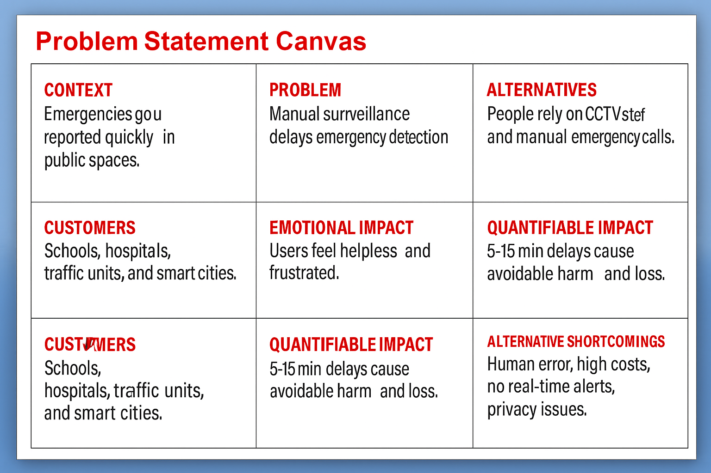
Problem Statement Canvas

Slide 4
PROPOSED SOLUTION
Sentinel AI is an AI-powered surveillance system that:
Detects incidents like violence, crashes, falls, or fires using live video feeds
Automatically sends real-time alerts to authorities or responders
Features privacy-first design with face anonymization
Works with existing CCTV infrastructure

Slide 5
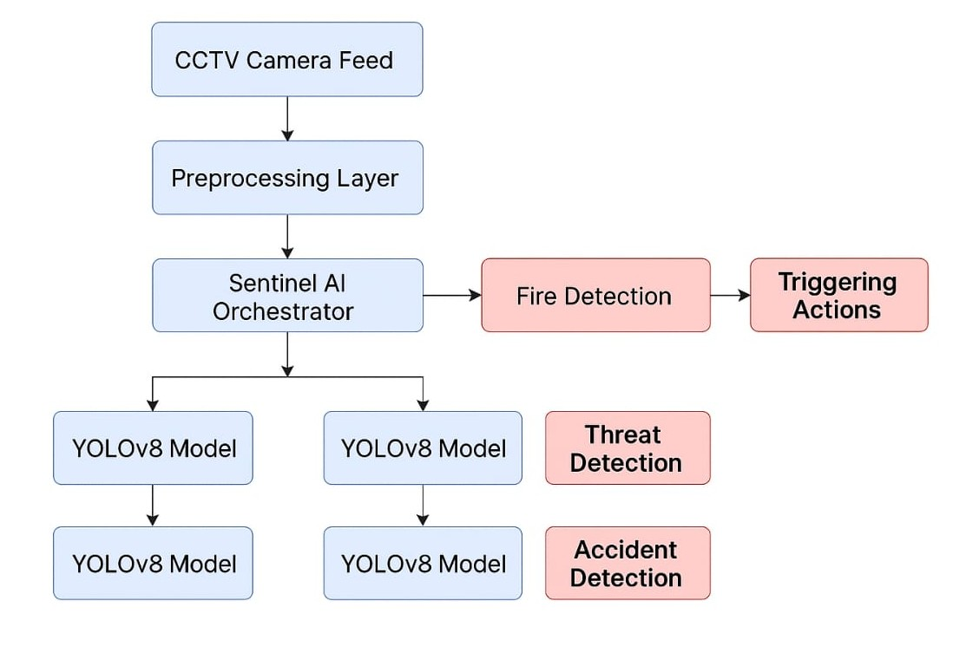
FLOW DIAGRAM

Slide 6
Existing Solution
CCTV + Guards: Slow, error-prone, no real-time alerts
Smart Cameras (Ring/Nest): Home-focused, not for public use
ShotSpotter: Only detects gunshots, pricey, not versatile
AI Cams (Axis/Hikvision): Expensive, privacy concerns, closed systems
Cloud AI (AWS/Google): Complex setup, high cost, dev-heavy
Drones: Not practical indoors, high legal/operational limits
Panic Buttons: Manual, no automation, no visuals

Slide 7
Thank You !!

